Slide 1
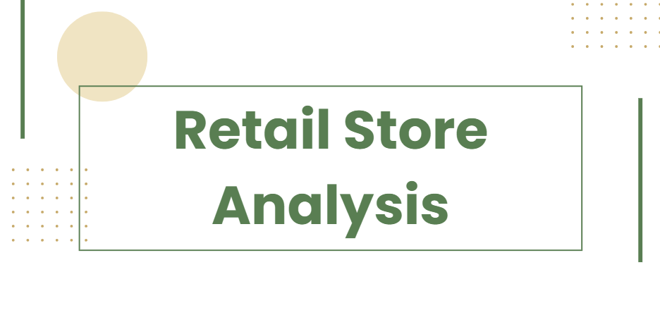

Slide 2
Payment method Distribution
34.5%
Cash
32.8%
Credit Card
32.7%
Digital wallet

Slide 3
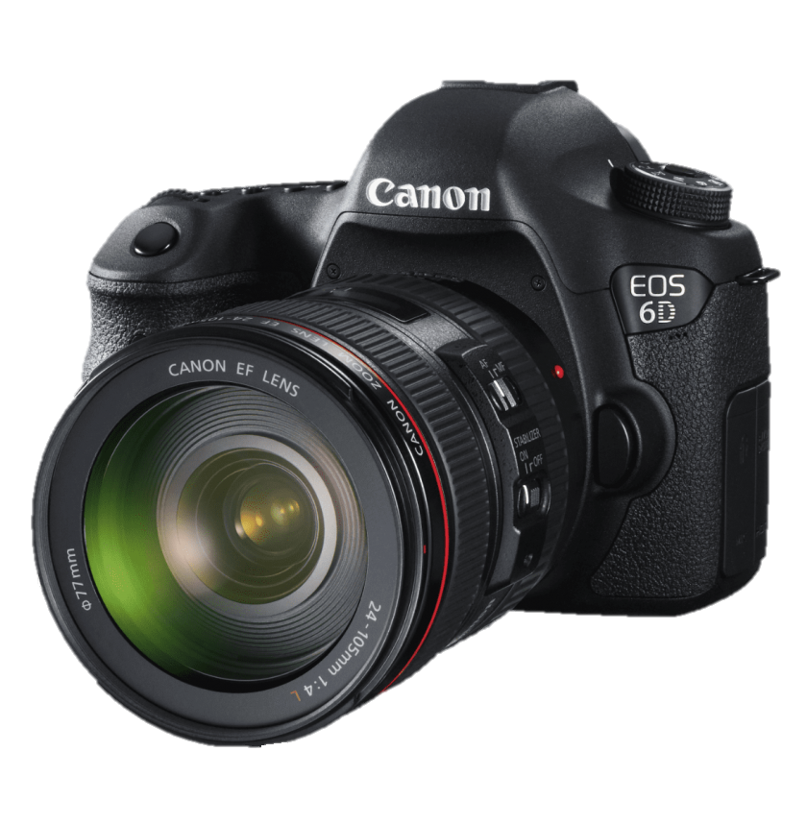
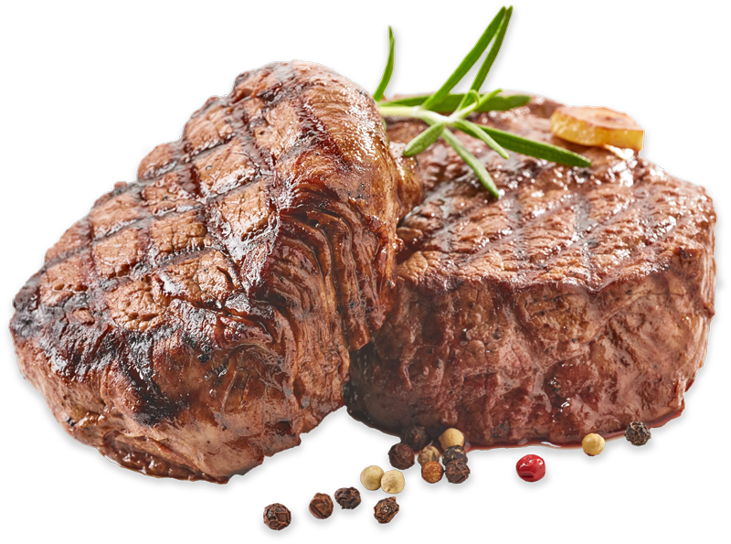
0 1
2
3
4
5
6
7
8
9
..
0 1
2
3
4
5
6
7
8
9
.
0 1
2
3
4
5
6
7
8
9
…
Quantity
Electronics
7774
7832
Butchers

Slide 4

0 1
2
3
4
5
6
7
8
9
..
0 1
2
3
4
5
6
7
8
9
…
0 1
2
3
4
5
6
7
8
9
.
Electronics
Quantity
Butchers
7832
7889
7774
Milk Products

Slide 5

0 1
2
3
4
5
6
7
8
9
..
Butchers
0 1
2
3
4
5
6
7
8
9
.
0 1
2
3
4
5
6
7
8
9
…
Electronics
Quantity
Milk Products
7774
7515
7889
Patisserie

Slide 6

0 1
2
3
4
5
6
7
8
9
..
Milk Products
0 1
2
3
4
5
6
7
8
9
…
0 1
2
3
4
5
6
7
8
9
.
Electronics
Quantity
Patisserie
7889
8083
7515
Furniture

Slide 7

0 1
2
3
4
5
6
7
8
9
..
0 1
2
3
4
5
6
7
8
9
…
Patisserie
0 1
2
3
4
5
6
7
8
9
.
Electronics
Quantity
Furniture
7515
7974
8083
Beverages

Slide 8
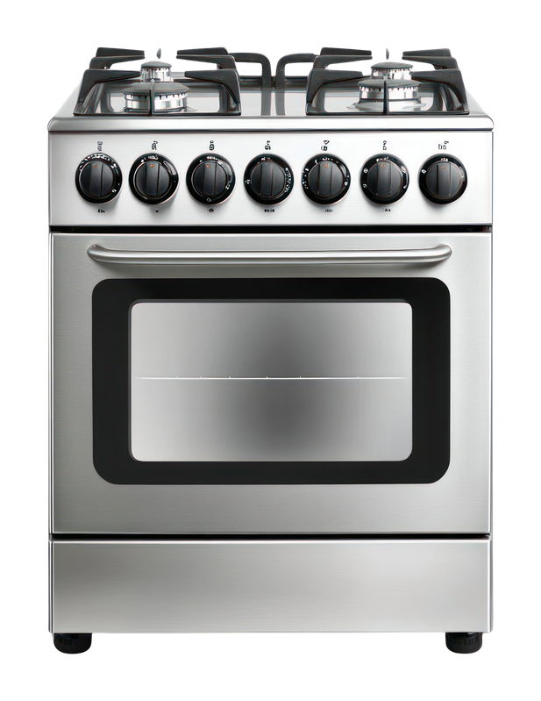
0 1
2
3
4
5
6
7
8
9
..
0 1
2
3
4
5
6
7
8
9
…
Furniture
0 1
2
3
4
5
6
7
8
9
.
Electronics
Quantity
Beverages
8083
7897
7974
Household Essentials

Slide 9
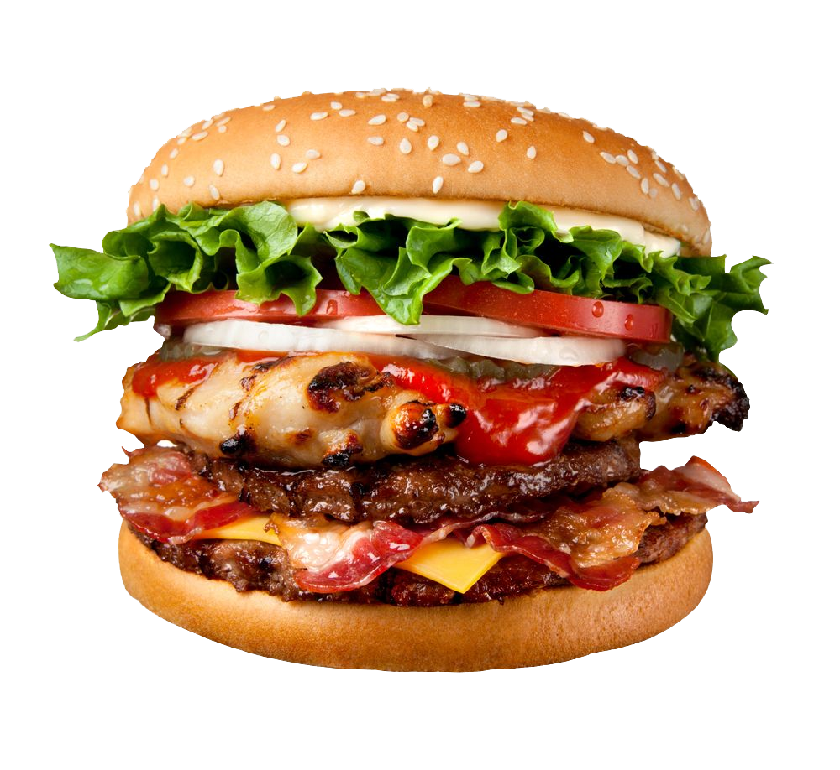
0 1
2
3
4
5
6
7
8
9
..
0 1
2
3
4
5
6
7
8
9
…
Beverages
0 1
2
3
4
5
6
7
8
9
.
Quantity
Household Essentials
7974
7925
7897
Food

Slide 10
0 1
2
3
4
5
6
7
8
9
..
0 1
2
3
4
5
6
7
8
9
…
Household Essentials
0 1
2
3
4
5
6
7
8
9
.
Quantity
Food
7897
7925

Slide 11
Online vs In-Store
Spending
%
Online Shopping demonstrates strong digital adoption and customer confidence in e-commerce
In-Store
50.9
49.1
%

Slide 12
Online vs In-Store
Spending
%
Online
In-Store Shopping provides that traditional shopping experiences remain highly valued.
49.1
50.9
%

Slide 13
avg
December
Monthly Transactions
894
Monthly Transactions
958

Slide 14
avg
December
November
Monthly Transactions
925
Monthly Transactions
894
Monthly Transactions
958

Slide 15
avg
December
November
October
Monthly Transactions
950
Monthly Transactions
925
Monthly Transactions
958
Monthly Transactions
894

Slide 16
avg
December
November
October
September
Monthly Transactions
988
Monthly Transactions
950
Monthly Transactions
958
Monthly Transactions
894
Monthly Transactions
925

Slide 17
avg
December
November
October
September
August
Monthly Transactions
988
Monthly Transactions
944
Monthly Transactions
958
Monthly Transactions
894
Monthly Transactions
925
Monthly Transactions
950

Slide 18
avg
December
October
September
August
July
November
Monthly Transactions
910
Monthly Transactions
958
Monthly Transactions
894
Monthly Transactions
925
Monthly Transactions
950
Monthly Transactions
988
Monthly Transactions
944

Slide 19
avg
December
October
September
August
July
June
November
Monthly Transactions
957
Monthly Transactions
910
Monthly Transactions
894
Monthly Transactions
925
Monthly Transactions
950
Monthly Transactions
988
Monthly Transactions
944
Monthly Transactions
958

Slide 20
avg
December
October
September
August
July
June
May
November
Monthly Transactions
957
Monthly Transactions
896
Monthly Transactions
925
Monthly Transactions
950
Monthly Transactions
988
Monthly Transactions
944
Monthly Transactions
910
Monthly Transactions
958
Monthly Transactions
894

Slide 21
avg
December
October
September
August
July
June
May
April
November
Monthly Transactions
988
Monthly Transactions
944
Monthly Transactions
910
Monthly Transactions
957
Monthly Transactions
896
Monthly Transactions
928
Monthly Transactions
958
Monthly Transactions
894
Monthly Transactions
925
Monthly Transactions
950

Slide 22
avg
December
October
September
August
July
June
May
April
March
November
Monthly Transactions
988
Monthly Transactions
944
Monthly Transactions
910
Monthly Transactions
957
Monthly Transactions
896
Monthly Transactions
928
Monthly Transactions
958
Monthly Transactions
894
Monthly Transactions
925
Monthly Transactions
950
Monthly Transactions
913

Slide 23
avg
December
October
September
August
July
June
May
April
March
February
November
Monthly Transactions
944
Monthly Transactions
910
Monthly Transactions
957
Monthly Transactions
896
Monthly Transactions
928
Monthly Transactions
958
Monthly Transactions
894
Monthly Transactions
925
Monthly Transactions
950
Monthly Transactions
988
Monthly Transactions
913
Monthly Transactions
1099

Slide 24
avg
December
October
September
August
July
June
May
April
March
February
November
January
Monthly Transactions
910
Monthly Transactions
957
Monthly Transactions
896
Monthly Transactions
928
Monthly Transactions
913
Monthly Transactions
1099
Monthly Transactions
894
Monthly Transactions
925
Monthly Transactions
950
Monthly Transactions
988
Monthly Transactions
944
Monthly Transactions
958

Slide 25
The End
Application

